Slide 1


DAYANANDA SAGAR ACADEMY OF TECHNOLOGY AND MANAGEMENT
Department Of Electronics And Communication
PROJECT REVIEW-IV
Batch No:6
RAMITHA.T – 1DT15EC062 GUIDED BY,
SANGEETHA.K.S – 1DT15EC068 Mrs. GARIMA PATHAK
SHREYA.R – 1DT15EC077 Assistant Professor
VINUTHA.S – 1DT15EC098 Dept. of ECE,DSATM

Slide 2
VEHICLE TO VEHICLE COMMUNICATION USING LIGHT FIDELITY FOR CRASH AVOIDANCE

Slide 3
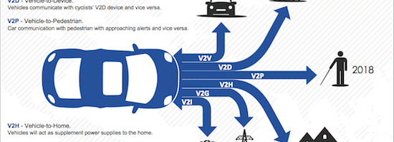

Slide 4
OUTLINE
DOMAIN INTRODUCTION
LITERATURE SURVEY
PROBLEM STATEMENT
OBJECTIVES
BLOCK DIAGRAM
EXPLAINATION WITH CIRCUIT DIAGRAM
ALGORITHM
PLANNED vs COMPLETED ACTIVITIES
TEST DETAILS
DOCUMENTED CODE FILES
EXPECTED vs ACTUAL RESULT
CORRECTIVE ACTION PLANNED
TIME LINE
DEMO PLAN
REFERENCES

Slide 5
DOMAIN INTRODUCTION
The Visible Light Communication (VLC) is a recent technology that uses light instead of radio frequency signals to transmit the data. Light Fidelity (Li-Fi) is a recent technology in VLC.
Li-Fi is the wireless communication system in which transmission of data is through illumination.
For vehicle safety a new technique called VANET is introduced.
VANET Communication is classified into two different types Vehicle to Vehicle communication (V2V) and Vehicle to infrastructure (V2I) communication.
The domain used in this project is Embedded system.
Embedded system is a combination of Hardware and software.
One of its important characteristics is that it gives output within time limits.
A modern day car has several individual embedded systems that performs specific tasks with the aim of making smooth and safe journey.
Some of the embedded systems in car are Antilock Braking System(ABS), Temperature Monitoring system, Automatic climate control, tyre pressure monitoring system, Engine oil level monitoring,etc.

Slide 6
LITERATURE SURVEY
AUTHORS | TITLE AND YEAR | CONTENT
SUKHVIR SINGH , G KAKAMANSHADI , SAVITHA GUPTA | VISIBLE LIGHT COMMUNICATION - AN EMERGING WIRELESS COMMUNICATION TECHNOLOGY. 2015 | Visible Light Communication was introduced to increase Data Rates in Wireless Communication . Light Fidelity (Li-fi) resolves the issue of Overuse of Radio Frequency Waves . Using led light the data rates of 10gbps was achieved.
MONISHA M, SUDHEENDRA G | LIFI – LIGHT FIDELITY TECHNOLOGY. 2017 | Li-fi is a Data Transmission Technique which uses light as a medium of Communication. By varying the Intensity of Led light the Data is transmitted .When Led Is turned on it transmits digital signal 1 and 0 when Led is turned off.
ALBERT DEMBA, DIETMAR P. F. MOLLER | VEHICLE TO VEHICLE COMMUNICATION TECHNOLOGY. 2018 | Vehicle to vehicle communication previously rely on GSM which has limited bandwidth and security constraints. Vehicle to vehicle communication uses a wireless protocol known as DSRC which is combined with GPS to provide communication in the range with 360 degree view.

Slide 7
D.N.S RAVI KUMAR,G NAGARAJAN | VEHICLE TO VEHICLE COMMUNICATION USING LI-FI TECHNOLOGY. 2018 | Using light the data is transmitted from one vehicle to other. The distance between the vehicles are measured using Ultra Sonic sensor to communicate with the vehicles in range.
D MOHAMMED,B D K DIHYA,M ABDELKRIM, K MOKHTAR | DIGITAL DATA TRANSMISSION VIA VLC: APPLICATION TO VEHICLE TO VEHICLE COMMUNICATION. 2016 | Inter– vehicular communication was feasible using Li-Fi . Different coding techniques were used for security reasons and experiments concluded that light intensity is a decreasing function of distance .
I TAKAI,T HARADA , M ANDOH,K YASUTOMI, K KAGAWA, S KAWAHITO | OPTICAL VEHICLE TO VEHICLE COMMUNICATION SYSTEM USING LED TRANSMITTER AND CAMERA RECEIVER. 2013 | It employs a special CMOS image sensor for collision avoidance. The LED detection method uses flag image and the camera receiver.

Slide 8
PROBLEM STATEMENT
The major challenge with existing technologies is its low data transmission , high power consumption and bandwidth problem occurs .
There is a need for an intelligent transport system and effective traffic management to ensure smooth operations and prevention of accidents.
Radio frequency waves are harmful for the environment and human beings.
The equipments used for the design such as camera used in current technology are too expensive.
GPS and GSM modules doesn’t work in the regions where network is poor.

Slide 9
OBJECTIVES
The main objective is to design a module for communication between vehicles using light as a medium.
To facilitate road safety, minimum distance between the vehicles should be maintained, in case of violation an alert message will be delivered.
As light can travel faster, it detects vehicles at faster rate than human eye. This acts as extended driver vision.
To reduce power consumption and to provide wide range of bandwidth.
Detection of obstacle or vehicles to avoid potential collision.

Slide 10
BLOCK DIAGRAM
DISPLAY
MICRO CONTROLLER
LI-FI RECEIVER
LI-FI TRANSMITTER
APR (RECORD AND PLAYBACK)
POWER SUPPLY
MEMS SENSOR

Slide 11
Working OF LI-FI TRANSMITTER SECTION
SWITCHES
ARDUINO UNO
ENCODER
VOICE
PRE-AMPLIFIER
POWER AMPLIFIER
LED DRIVER
LED
WORKING OF LI-FI RECEIVER SECTION
PHOTO TRANSISTOR
AMPLIFIER
POWER AMPLIFIER
DECODER
LOAD
LCD
16*2
ARDUINO UNO
BUFFER
DRIVER

Slide 12
BLOCK DIAGRAM EXPLANATION ARDUINO UNO
The Arduino Uno is a microcontroller board based on the ATmega328 .
It has 14 digital input/output pins (of which 6 can be used as PWM outputs), 6 analog inputs, a 16 MHz ceramic resonator, a USB connection, a power jack, an ICSP header and a reset button.
Simply connect it to a computer with a USB cable or power it with a AC-to-DC adapter or battery to get started with the operating voltage of 5V.
LED DRIVERS(UDN2981A)
Drivers are useful for interfacing between low-level logic and high-current loads. Typical loads include relays, LEDs , etc..
It operates with a minimum of 5 V.
The suffix ‘A’ indicates an 18-lead plastic dual in-line package with copper lead frame for optimum power dissipation.

Slide 13
LCD
It is a 16 character, 2-line alphanumeric LCD display connected.
The LCD display requires data in a serial format. The display also requires a 5V power supply.
The potentiometer RV1 is a contrast control that should be used to adjust the contrast of the display.
PHOTO TRANSISTOR
Photo transistor is an electronic switching and current amplification component.
Photo transistor is made up of semiconducting material.
It converts light signal to electrical signal.

Slide 14
TRANSMITTER/RECEIVER OF VEHICLE-1
5V
LCD(16*2)
D7 D6 D5 D4 EN RW RS
2
3
4
5
ARDUINO UNO
11
GND
12
6
7
8
9
10
14
15
16
LIFI TRANSMITTER
GND
1
0
5V
LIFI RECEIVER
APR VOICE
1
2
3
4
5
6
7
8
0
1
GND
SPEAKER
APR (Record and play back)

Slide 15
TRANSMITTER/RECEIVER OF VEHICLE-2
LCD(16*2)
D7 D6 D5 D4 EN RW RS
5V
2
3
4
5
ARDUINO UNO
11
GND
12
6
7
8
9
10
14
15
16
LIFI TRANSMITTER
GND
1
5V
LIFI RECEIVER
APR (Record and play back)
1
2
3
4
5
6
7
8
0
GND
SPEAKER

Slide 16
ALGORITHM
Step 1: Designing a Li-fi transmitter and receiver modules
Step 2 : Calibrating and achieving synchronization between transmitter and receiver
Step 3: exchange of data between the vehicles
1. Vehicle 1 transmitter will be calibrated with vehicle 2 Receiver
2. Vehicle 2 transmitter will be calibrated with vehicle 1 receiver
On receiving the values like speed , fuel , brake failure , accident detection the appropriate actions are taken like stopping the vehicle Alerting through voice.

Slide 17
PLANNED VS COMPLETED ACTIVITIES
MONTH | PLANNED | COMPLETED
DECEMEBER | Study About LIFI technology | Studied about Li-Fi technology.
JANUARY | Conceptual study about Vehicle to vehicle communication | Completed the study
FEBRUARY | Software code for Arduino board. Interfacing ultrasonic sensor for Arduino. Interfacing of LED’s at the transmitter and photodetector at the receiver side is done. Measurement of distance when sensors were interfaced with Arduino board. | Code was written and made to run minimal results. Interfacing ultrasonic sensor for Arduino was done and tested.

Slide 18
MONTH | PLANNED | COMPLETED
MARCH | Software code for Arduino was developed. Interfacing the accident sensor, APR(Automatic play back and record) for Arduino. Interfacing of LCD to Arduino. Making overall connections. Li-fi transmitter and receiver testing and implementation. Accident avoidance. | Proper code executed. The vehicles which are in line of sight was detected and the vehicles which are at left, right, rear directions are identified using photo detector and the information is displayed on LCD using Li-Fi technology.

Slide 19
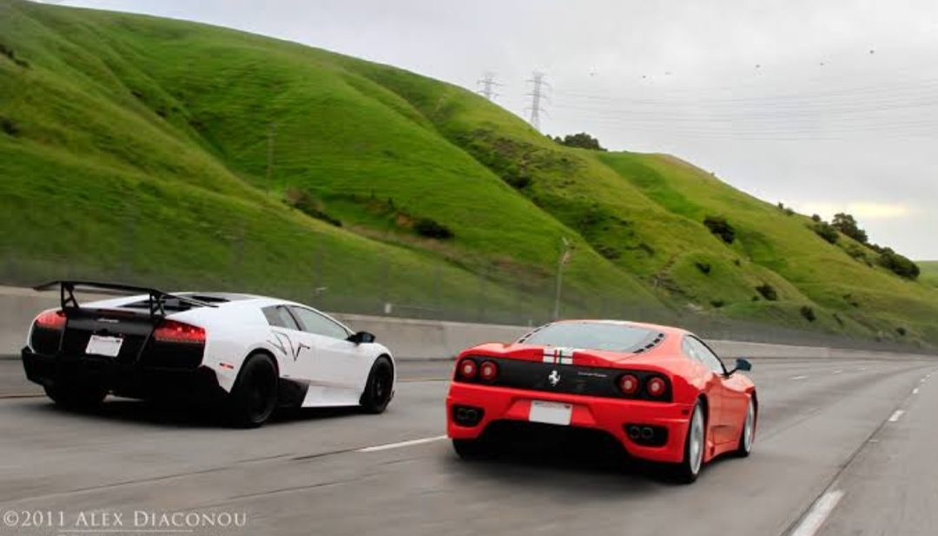
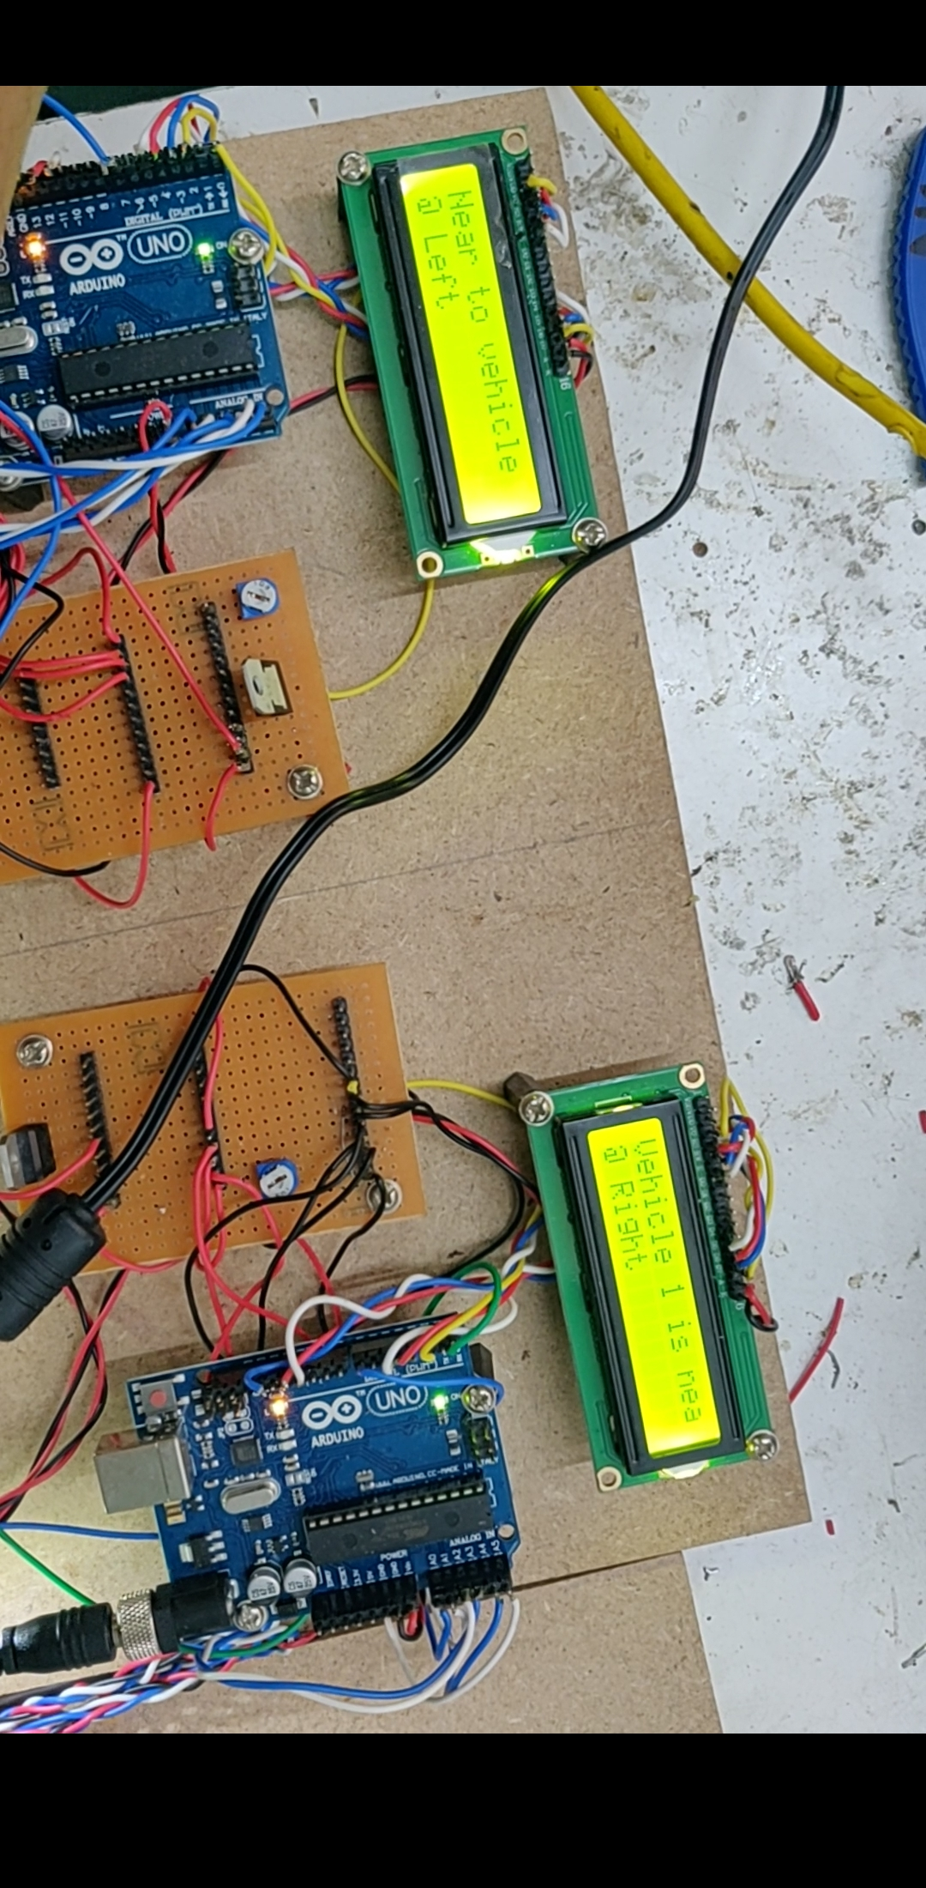
Test details
When the vehicle 1 approaches vehicle 2 in the west direction,
the data is displayed on the LCD of Vehicle 2 which says that the vehicle 1
is in the left direction with respect to vehicle 1.
VEHICLE 1
VEHICLE 2

Slide 20

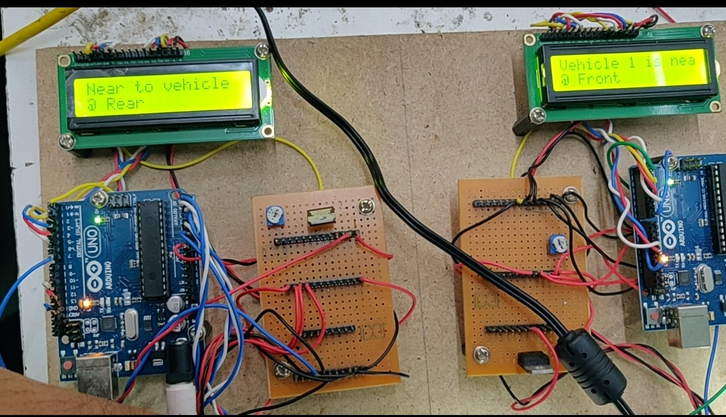
When the light rays from the vehicle 1 is detected from the photodetector
which is at the rear end, the message is displayed on the
vehicle 2’s LCD telling that the vehicle 1 is in the front end.
VEHICLE 2
VEHICLE 1

Slide 21
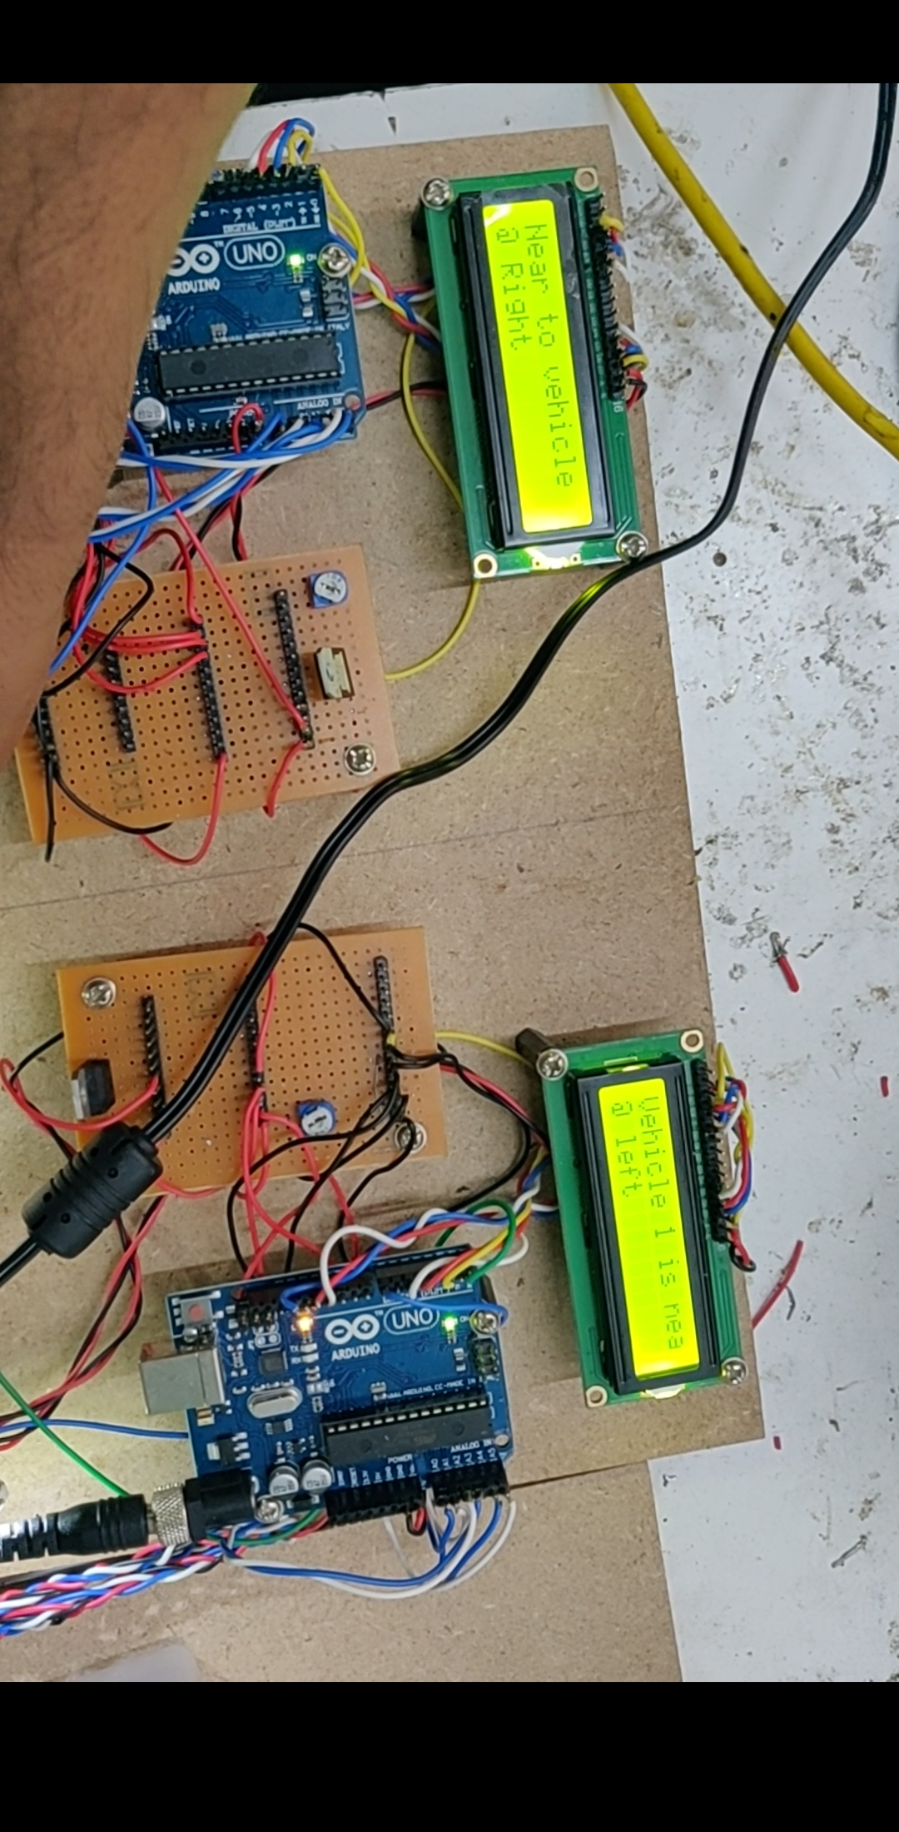
When the vehicle 1 approaches vehicle 2 in the east direction,
the data is displayed on the LCD of Vehicle 2 which says that the vehicle 1
is in the right direction with respect to vehicle 1.
VEHICLE 2
VEHICLE 1

Slide 22
code
#define LED 13 #define IR 10 void setup() { // put your setup code here, to run once: pinMode(IR,INPUT); pinMode(LED,OUTPUT); digitalWrite(LED,LOW); Serial.begin(9600); } void loop() { // put your main code here, to run repeatedly: if((digitalRead(IR)==LOW)) { Serial.println("LED=HIGH"); digitalWrite(LED,HIGH); } else { Serial.println("LED=LOW"); digitalWrite(LED,LOW); }}

Slide 23
EXPECTED VS ACTUAL RESULTS
EXPECTED VS ACTUAL RESULTS
EXPECTED | ACTUAL
Data Transfer between Li-fi Tx and Rx | Communication Achieved
Switches connected to microcontroller for showing different options such as speed etc. | Synchronization achieved
Communication Between vehicles | Line of sight communication achieved

Slide 24
CORRECTIVE ACTION PLANNED
Initial plan was to design the project using Arduino uno.
As there are shortage of pins in the Arduino due to the use of 6 ultrasonic sensors which are for the front, back and rear end directions, the ultra sonic sensors which are used for the left and right direction detection of vehicles are removed and its been replaced by the switches.
The key elements of switches are used for multi purposes like brake failure, fuel monitoring, MEMS sensors are used for accident avoidance.
Also APR(Automatic playback and record ) is used as the speakers for the audio information for the drivers .

Slide 25
TIME LINE
YEAR | MONTH | WORKING
2018 | October | Synopsis
2018 | November | Literature survey
2019 | January and February | Block Diagram , Hardware and interfacing
2019 | March | Writing code for interfacing
2019 | April | Final hardware and software implementation

Slide 26
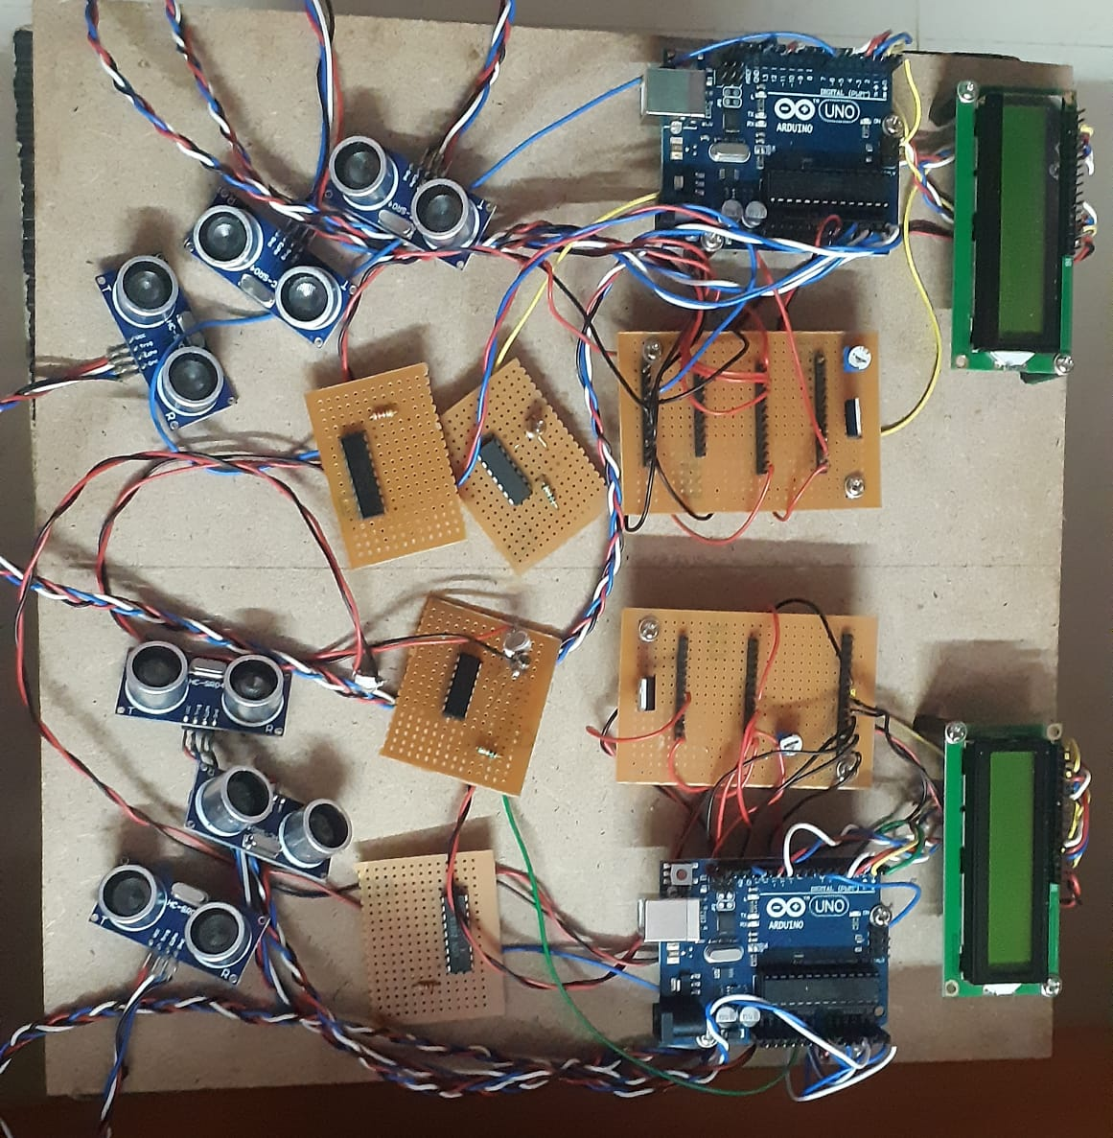
DEMO PLAN

Slide 27
REFERENCES
T Harada, M Andoh ,K Yasutomi ,K Kagawa, S Kawahito ,Isamu Takai, “Optical Vehicle- to-Vehicle Communication System Using LED Transmitter and Camera Receiver”, IEEE Photonics Journal , Vol. 6, No. 5, October 2014.
M Mohd Tali, Aarti Patil, Sushmita Chavan, Shailesh Jadhav , “Inter- vehicle communication using Li-Fi technology” , IJARCCE, march- 2017.
Rashmi Thakur, Sneha Balkawade, Vishakha More, Bhakti Patil, “Inter vehicular communication using Li-Fi”, IJRASET, Jan-2018.
Ambuj Kumar and Rajendea Prasad Nayak,”An Efficient Group-Based Safety Message Transmission Protocol for VANET”,IEEE International Conference on communication and signal processing , April 3-5,2013 India, pp. 1 -4.
D.Mohammed, B D K Dihya, M.Abdelkrim, K.Mokhtar, “Digital Data transmission via visible light communication: Applications to vehicle to vehicle communication”,4th international conference,dec-2016.

